Slide 1
Foundation of Machine Learning and Python libraries

Slide 2
Outline
Key python libraries
Numpy
Pandas
Matplotlib
Scikit-learn
TensorFlow
Machine Learning workflow
Cloud machine – Google Colab

Slide 3
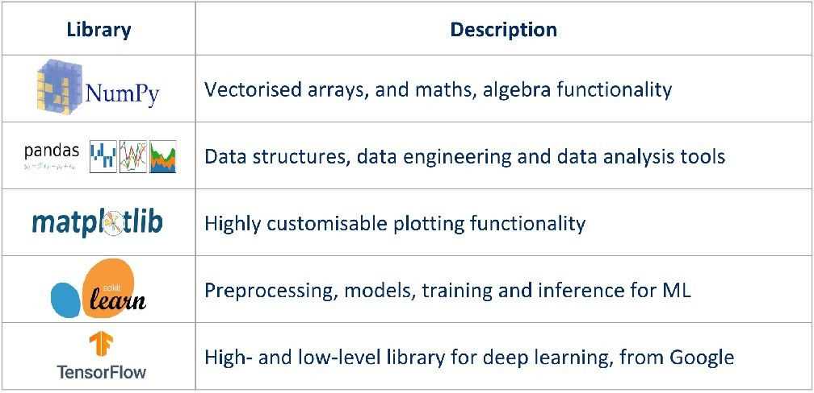
Python libraries stack

Slide 4
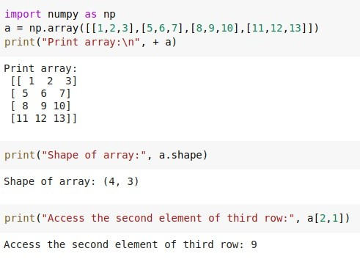
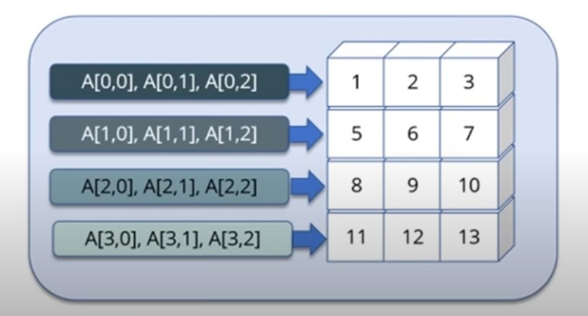
Numpy

Slide 5
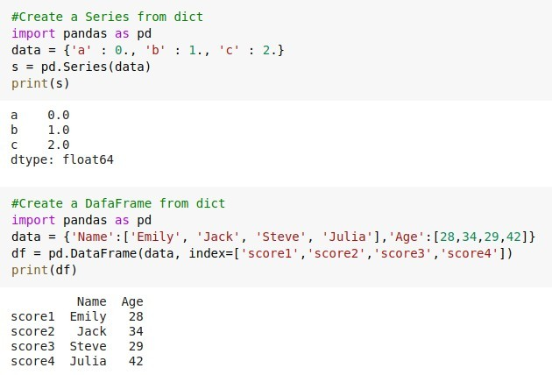
Pandas

Slide 6
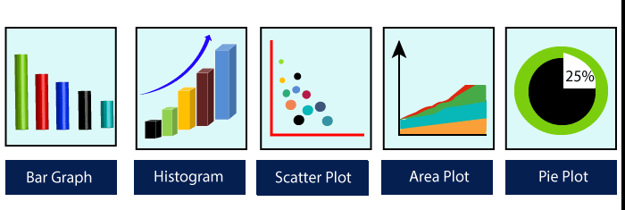
Matplotlib

Slide 7
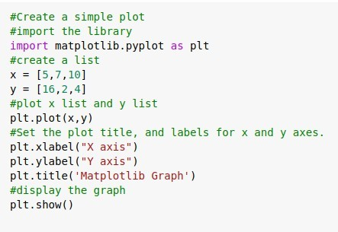
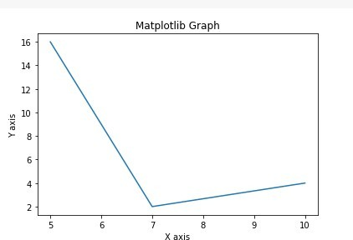
Matplotlib

Slide 8
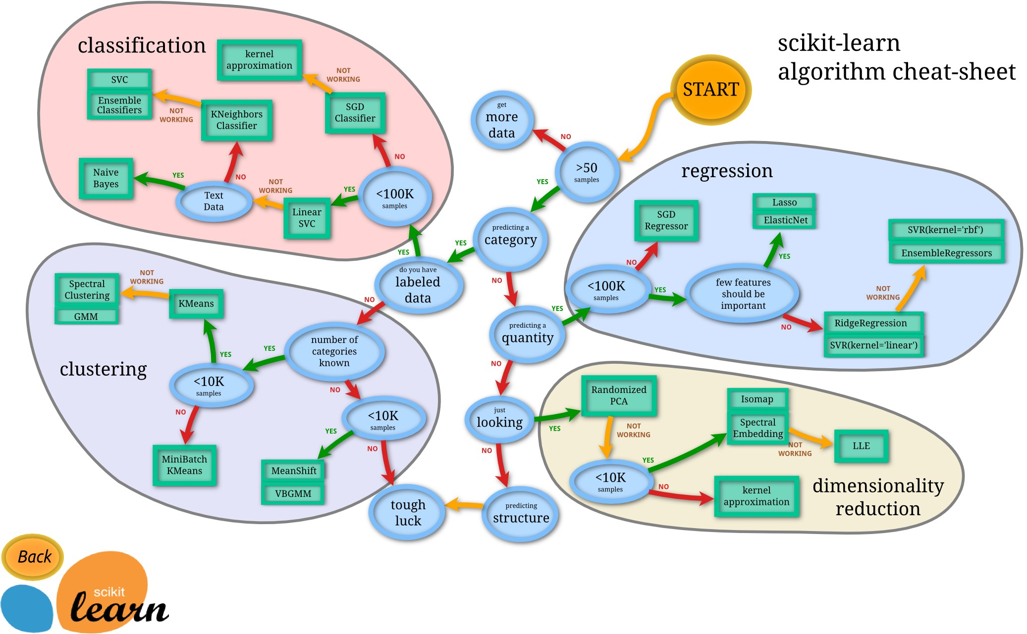
Scikit-Learn

Slide 9
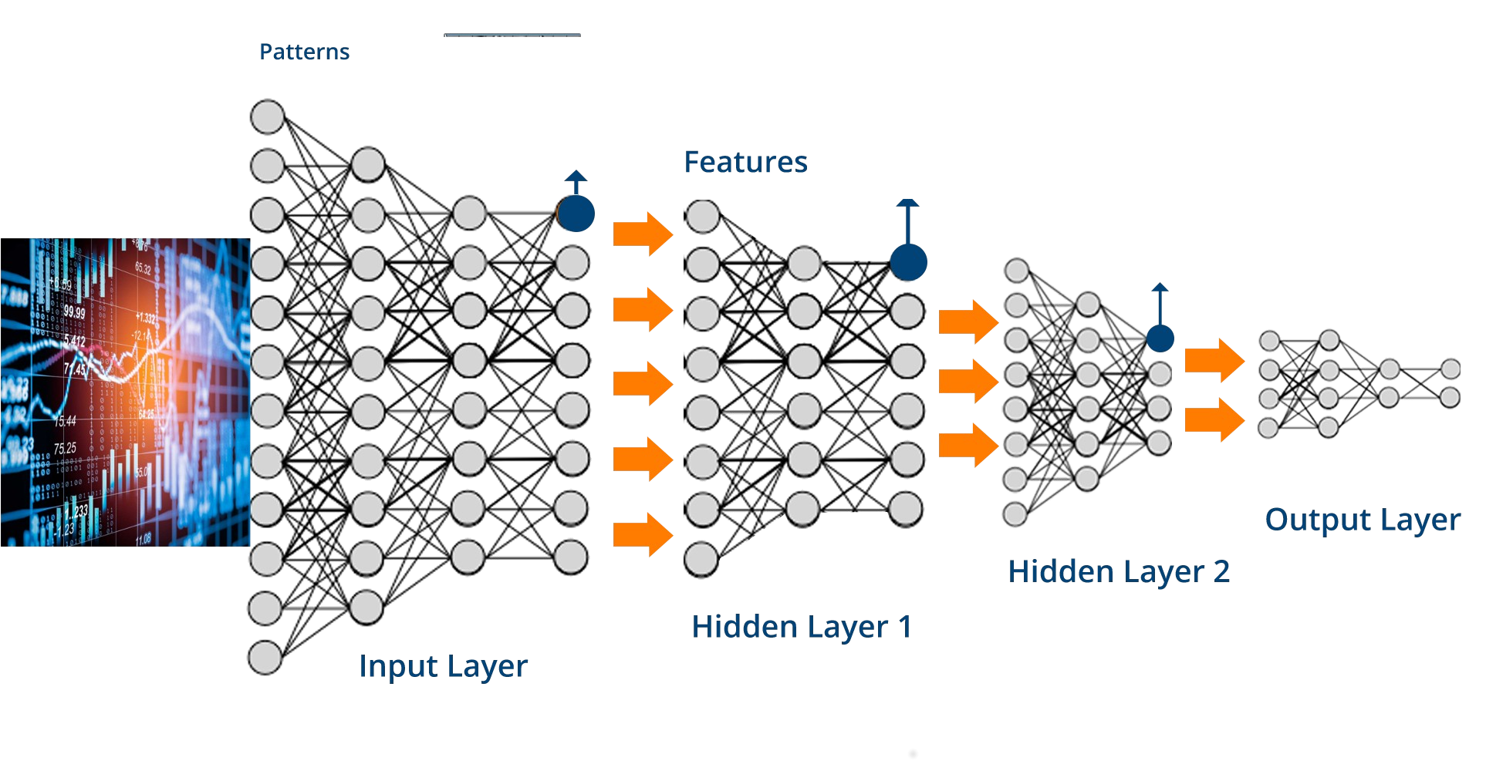
TensorFlow

Slide 10
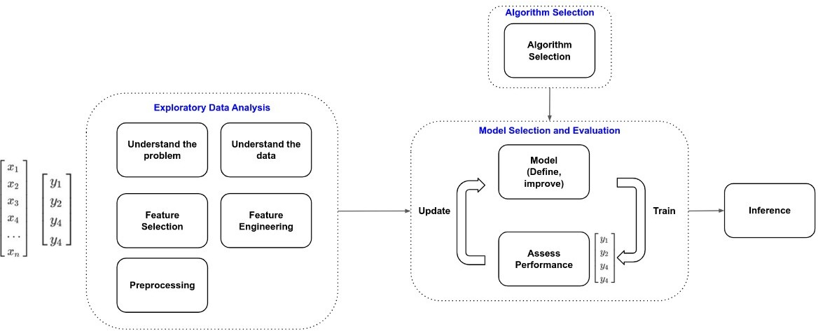
Machine Learning Workflow

Slide 11
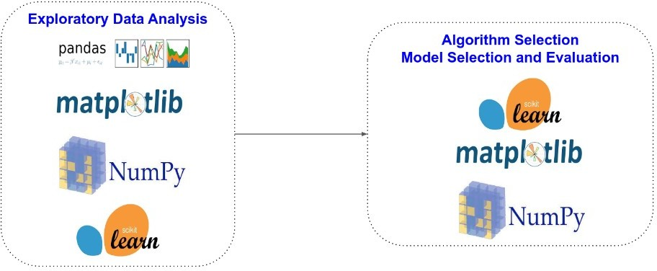
Machine Learning Workflow

Slide 12
Get started with Google Colaboraty

Slide 13
Cloud Machine (Free GPU)
Colaboratory, or “Colab” for short, is a product from Google Research. Colab allows anybody to write and execute arbitrary python code through the browser, and is especially well suited to machine learning, data analysis and education. More technically, Colab is a hosted Jupyter notebook service that requires no setup to use, while providing free access to computing resources including GPUs.
Frequently asked questions: https://research.google.com/colaboratory/faq.html#:~:text=Colaboratory%2C%20or
%20%E2%80%9CColab%E2%80%9D%20for,learning%2C%20data%20analysis%20and
%20education

Slide 14
Cloud Machine (Free GPU)
Colaboratory, or “Colab” for short, is a product from Google Research. Colab allows anybody to write and execute arbitrary python code through the browser, and is especially well suited to machine learning, data analysis and education. More technically, Colab is a hosted Jupyter notebook service that requires no setup to use, while providing free access to computing resources including GPUs.
Frequently asked questions: https://research.google.com/colaboratory/faq.html#:~:text=Colaboratory%2C%20or
%20%E2%80%9CColab%E2%80%9D%20for,learning%2C%20data%20analysis%20and
%20education

Slide 15
Get started to use Google Colaboraty
First of all, you need to have a Google account.
References:
https://www.youtube.com/watch?v=inN8seMm7UI&ab_channel=TensorFlow
https://research.google.com/colaboratory/ https://towardsdatascience.com/getting-started-with-google-colab-f2fff97f594c

Slide 16
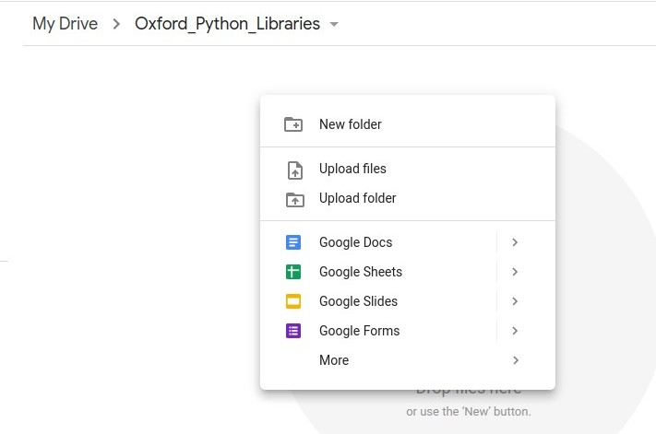
Google Colaboraty
Open Google Drive and create a folder (ex:Oxford_Python_Libraries)
Upload the Jupyter notebooks from your local computer to the Google Drive. Right click and click on “Upload files”.

Slide 17
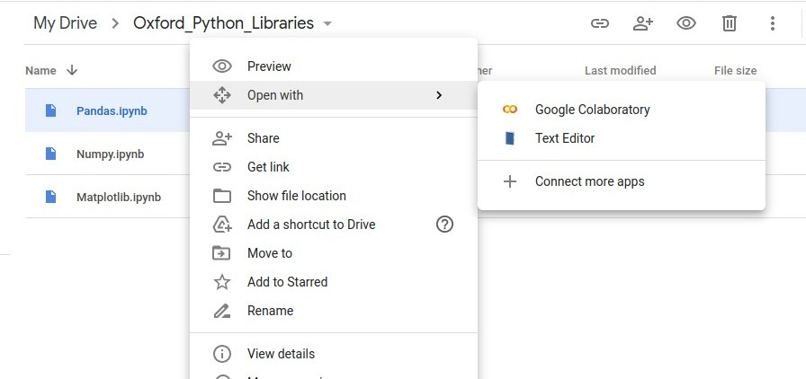
Google Colaboraty
Right click on “Open the notebook with Google Colaboratory”. If it is first time for you, firstly Click on “Connect more apps”and install Google Colab.

Slide 18
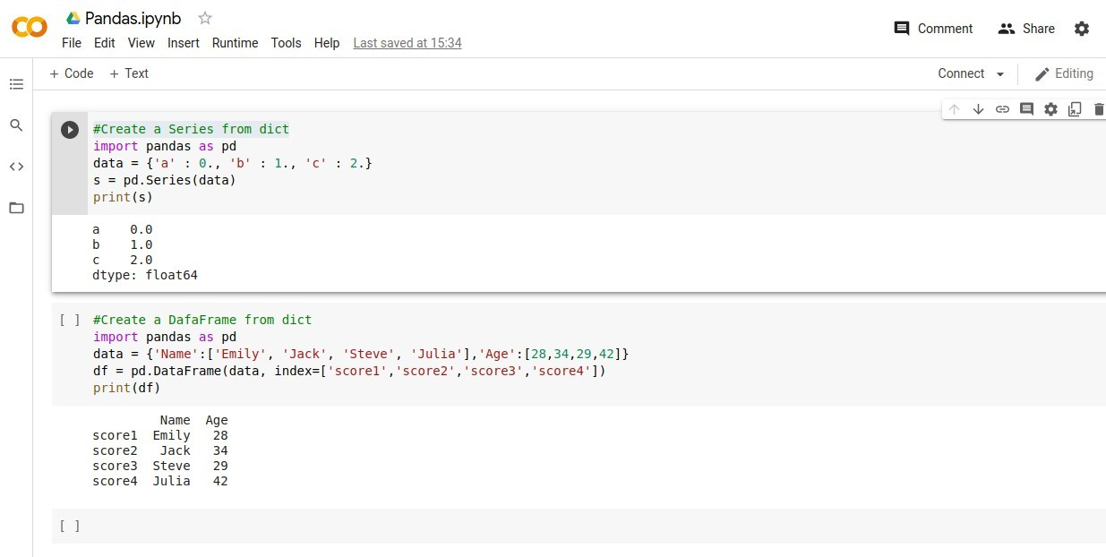
Google Colaboraty Each time when you open the file, you need initialize a cloud machine. Cilck on “Connect”. Now google cloud is going to give you a virtual machine hosted Jupiter notebook server on the cloud.

Slide 19
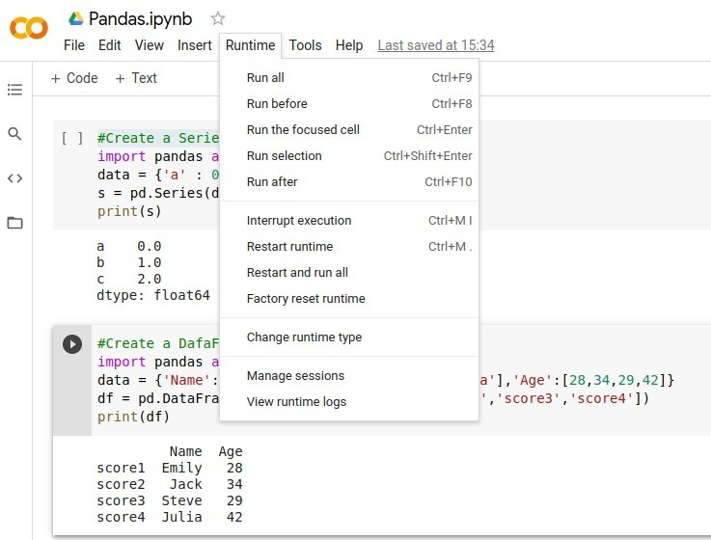
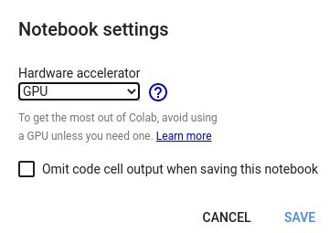
Google Colaboraty You have free access to GPU or TPU with Colab. To change runtime, go to “Runtime→Change runtime type”.

Slide 20
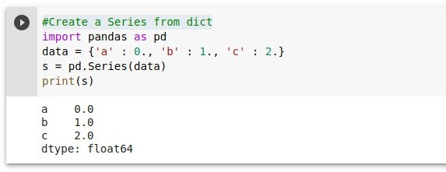
Google Colaboraty Press the “Shift+Enter” to run the code cell.
or
Use keyboard shortcut (Ctrl + Enter) to run the code cell.

